Slide 1


Kingdom of Saudi Arabia
Ministry of Education
Shaqra University
College of Sciences and Humanities
الـمـمـلـكـة الـعـربـيـة الـسـعـوديـة
وزارة الـتـعـلـيـم
جـامـعـة شقراء
كلية العلوم والدراسات الإنسانية بعفيف
نظم قواعد البيانات
Select from multiple tables
أمير محمد المنصف الحمامي

Slide 2

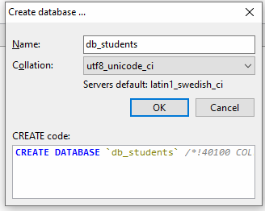
Select from multiple tables
Consider the following database:

Slide 3
Select from multiple tables
Consider the following table:
create table departments (
id_dept int primary key auto_increment,
name_dept varchar(100) default ''
);
insert into departments (name_dept) values ('الحاسب الآلي’);
insert into departments (name_dept) values (‘الرياضيات’);

Slide 4
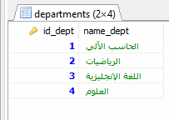
Select from multiple tables
Add English dept and Sciences dept using only one query:
Solution: use multiple insert
insert into departments (name_dept)
values (‘اللغة الغنجليزية’), (‘العلوم’);;
Display table content:
select * from departments;

Slide 5
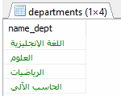
Display only the department name
select name_dept from departments;
Ordered
select name_dept from departments order by name_dept desc;

Slide 6

Search department containing letter ر
select * from departments where name_dept like '%ر%’;

Slide 7


select * from departments where name_dept like '%الآلي’;
تنتهي بكلمة الآلي
select * from departments where name_dept like 'الآلي%’;
تبدأ بكلمة الآلي

Slide 8
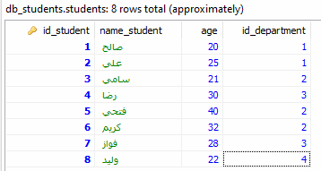
Consider the following table:
create table students (
id_student int primary key auto_increment,
name_student varchar (100) default '',
age int default 0,
id_department int
);

Slide 9
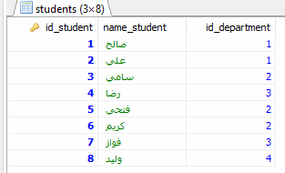
Display student id, name and department id
select id_student, name_student, id_department from students;

Slide 10
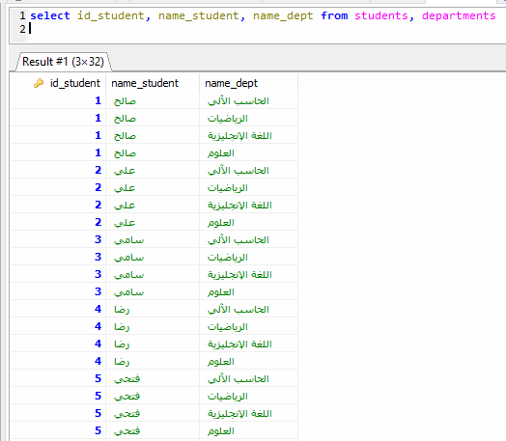

Slide 11
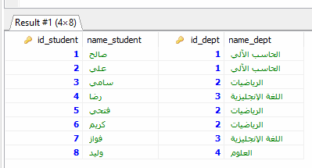
select id_student, name_student, id_dept, name_dept from students, departments
where students.id_department = departments.id_dept;
Join Condition

Slide 12

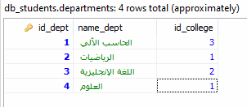
create table colleges (
id_college int primary key auto_increment,
name_college varchar(200) default ''
);

Slide 13
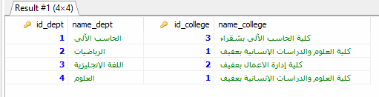
select id_dept, name_dept, colleges.id_college, name_college from departments, colleges
where departments.id_college = colleges.id_college;

Slide 14
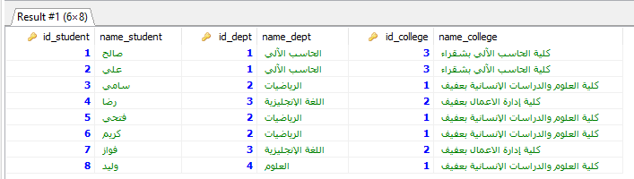
select id_student, name_student, id_dept, name_dept, colleges.id_college, name_college
from students, departments, colleges
where
students.id_department = departments.id_dept
and
departments.id_college = colleges.id_college;

